Slide 1
SIMULATION OF MOLECULAR DYNAMICS USING OPENMP
Parallel and Distributed Computing
J-Component

Slide 2
Group Members
1

Slide 3
Team
Zara Iqbal
19BCE1710
Keshav Bhatia
19BCE1709
Isaac Emmanuel
19BCE1750

Slide 4
Review-1

Slide 5
Objective
2

Slide 6
Objective
The main objective of this project experiment is to decrease the amount of time taken to compute the potential and kinetic energies of atoms. For the same reason, we are also paralleling the compute and update function as they do most of the calculation. Another objective of the project is to simulate the decrease in the error of theoretical and practically observed energies.

Slide 7
Abstract
3

Slide 8
Abstract
Molecular-dynamics (MD) simulation is a well-progressed numerical method that shows the use of a suitable algorithm to solve the classical equations of motion for atoms relating with a known interatomic potential. MD simulation techniques are well suited for studying surface phenomena, as they give a qualitative explanation of surface structure and dynamics. We are going to parallelize the serial simulation of Molecular Dynamics which will help us to save time.

Slide 9
Literature Survey
4

Slide 10
First Paper:Couturier, R. and Chipot, C., 2000. Parallel molecular dynamics using OpenMP on a shared memory machine.
The strength of this approach lies in the possibility to proceed incrementally, with only a few alterations of the original, scalar code. If do-loop splitting with OpenMP is certainly less efficient than domain decomposition (DD) approaches, its fast implementation, requiring little knowledge of the source code, also involves significantly less programming effort. Linear wallclock speed-up ratios using four processors, and ranging between 6.0 and 7.0 with eight, underline the cost-effectiveness of OpenMP directives

Slide 11
Second Paper: Tarmyshov, K.B. and Müller-Plathe, F., 2005. Parallelizing a molecular dynamics algorithm on a multiprocessor workstation using OpenMP.
The atomistic molecular dynamics program YASP has been parallelized for shared-memory computer architectures. Parallelization was restricted to the most CPU-time-consuming parts: neighbor-list construction, calculation of nonbonded, angle and dihedral forces, and constraints. Only in the case of the neighbor list did the data structure have to be changed. The parallel code achieves a useful speedup over the sequential version for systems of several thousand atoms and above. On an IBM Regatta p690+, the throughput increases with the number of processors up to a maximum of 12−16 processors depending on the characteristics of the simulated systems. On dual-processor Xeon systems, the speedup is about 1.7.

Slide 12
Third Paper:Procacci, P., 2016. Hybrid MPI/OpenMP implementation of the ORAC molecular dynamics program for generalized ensemble and fast switching alchemical simulations.
We present a new release of the ORAC program with a hybrid OpenMP/MPI multilevel parallelism tailored for generalized ensemble (GE) and fast switching double annihilation (FS-DAM) nonequilibrium technology aimed at evaluating the binding free energy in drug-receptor system on high performance computing platforms. The efficiency, simplicity, and inherent parallel nature of the ORAC implementation of the FS-DAM algorithm, project the code as a possible effective tool for a second generation high throughput virtual screening in drug discovery and design.

Slide 13
Research Gaps
5

Slide 14
Research Gaps
Structural changes in proteins can take nanoseconds (10–9 s), microseconds (10–6 s), milliseconds (10–3 s), or longer – Millions to trillions of sequential time steps for nanosecond to millisecond events (and even more for slower ones) Until lately, simulations of 1 microsecond were unusual.
Advances in computer power have allowed microsecond simulations, but simulation periods continue a challenge. Enabling longer-timescale simulations is an active research area, connecting: Algorithmic developments Parallel computing Hardware: GPUs, specialized hardware

Slide 15
Architecture Diagram
6

Slide 16
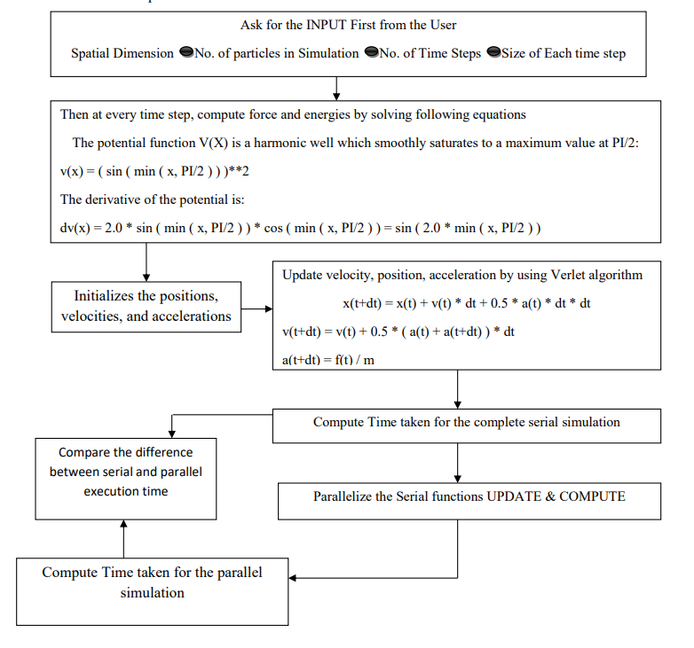

Slide 17
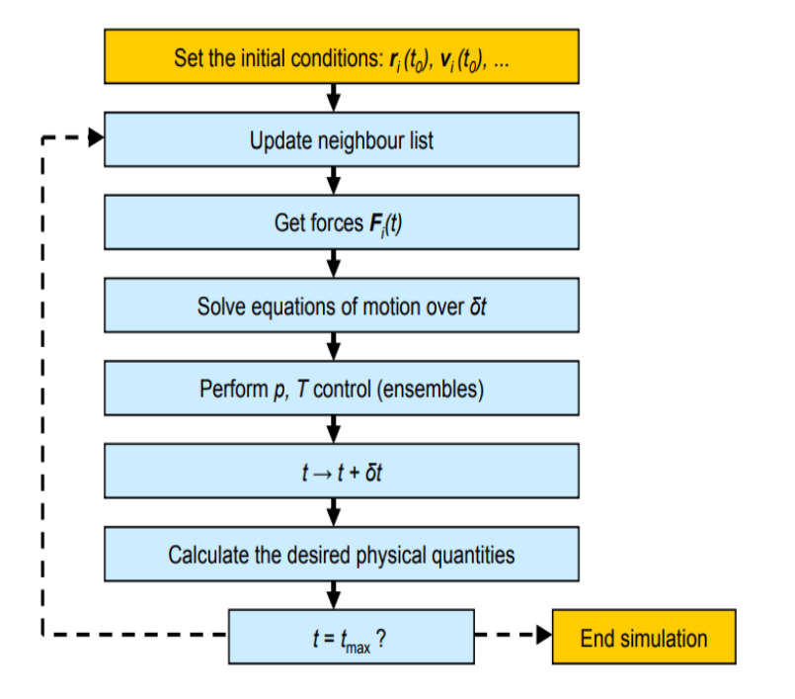
Architecture Flow Diagram

Slide 18
Review-2

Slide 19
Proposed Work
We will write a code which will expect the kinetic and potential energy of an atom at all time step which will help us in foreseeing the motions (velocity, position acceleration etc) of the atoms. The sum of kinetic energy and potential energy must be constant and equal to total energy our code will also print the error in total energy which will tell us about what percentage of error we can get in our calculations.

Slide 20
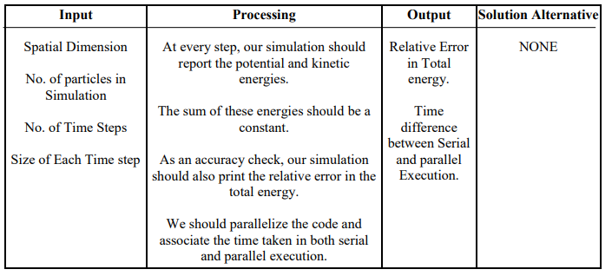
PAC Analysis

Slide 21
Expected Output
The main outcome we are expecting from this project is the decrease in amount of time taken to compute the potential and kinetic energies of atoms and that is also the reason why we are paralleling the compute and update function as they do most of the calculation. Another Outcome which we are expecting from this simulation is decrease in the error of theoretical and practically observed energies. Lesser the error, more the accuracy but we also know we cannot have the error free output but we are doing our best to make it very small by do not taking approximation of most of the values in calculation part

Slide 22
Modules
Compute: - COMPUTE computes the forces and energies of atoms.
Initialize: - INITIALIZE initializes the positions, velocities, and accelerations.
Timestamp: - TIMESTAMP prints the current YMDHMS date as a time stamp.
Update: - UPDATE updates positions, velocities and accelerations.
Displacement: - DISPLACEMENT computes the displacement between two particles.
CPU Time: - CPU_TIME reports the elapsed CPU time.

Slide 23
Implementation

Slide 24
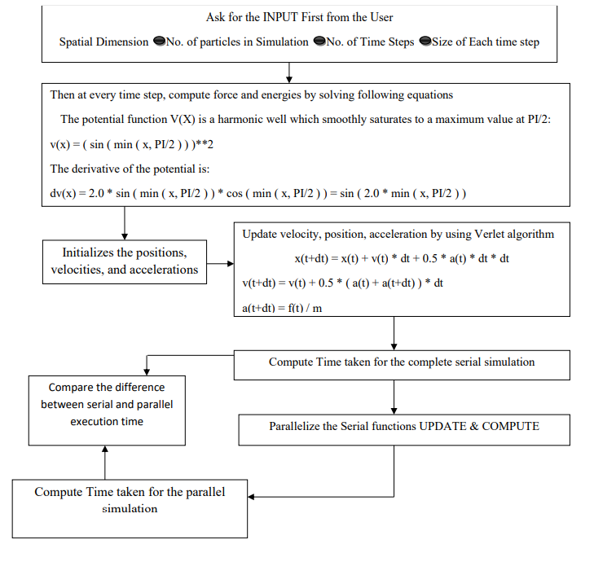
Implementation Flowchart

Slide 25
Review-3

Slide 26
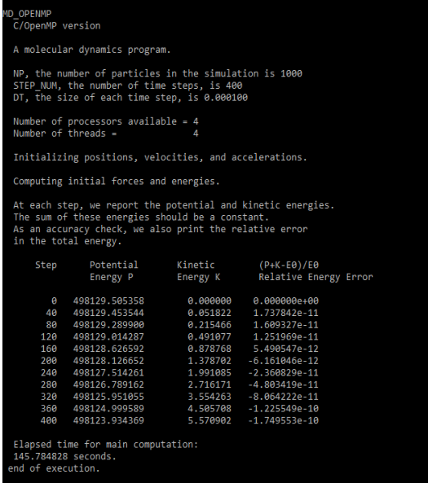
Output

Slide 27
Conclusion
In this project we present a new approach to accelerate molecular dynamics simulations with inexpensive product graphics hardware. To derive an effective mapping onto this type of computer architecture, we have used the new Compute Unified Device Architecture programming interface to implement a new parallel algorithm. Our experimental results show that the parallel algorithm based method allows speedups of up to fifteen seconds compared to the corresponding sequential implementation. This speed up can also be enhanced when we increase number of atoms and number of time steps

Slide 28
Future Research
We can include Graphics processing units (GPUs), originally developed for interpreting real-time effects in computer games, now provide unparalleled computational power for scientific applications. We can develop a general purpose molecular dynamics code that runs completely on a single GPU. It is expected that our GPU application can provide a presentation equivalent to that of fast 30 processor core distributed memory cluster. Results of this can show that GPUs implementation as an inexpensive another to such clusters and discuss implications for the future

Slide 29
Thank You!

